Slide 1









Karnatak Law Society's
INSTITUTE OF TECHNOLOGY (VDIT)
Transforming Through Technology
1939
2004
Department of
Computer Science and Engineering (AIML)
2023
w w w . k l s v d i t . e d u . i n

Slide 2
Mini Project Presentation entitled
An Interactive Power BI Dashboard for Analyzing Student Performance
Mini Project Associates
Ms. Krutika Sambranikar
Ms. Noorussaba Pakali
Ms. Sadiya Hospetkazi
Ms. SayyedaAfreen Khatib
(2VD22CI018) (2VD22CI029) (2VD22CI039) (2VD22CI045)
Department of Computer Science and Engineering (AIML)
AY: 2024-25 (Scheme: 2022)
23/12/2024
2

Slide 3


Introduction
1. Comprehensive Student Analysis: The dashboard combines academic, behavioral, and socioeconomic factors for a complete view of student success.
2. Key Metrics:It evaluates academic performance, mental health, social influences, and socioeconomic conditions.
3. Interactive Features:Users can filter and explore data to understand the impact of various factors on student outcomes.
4. Actionable Insights:Educators and policymakers can identify trends and create targeted interventions to improve student performance.

Slide 4

Motivation
1.Holistic Student Analysis:Combines academic, behavioral, psychological, and socioeconomic factors for a complete view of student performance.
2. Data-Driven Insights:Provides real-time, interactive analytics to help institutions make informed decisions on student success.
3. Personalized Interventions:Identifies individual needs for tailored support in areas like anxiety, backlogs, and socioeconomic challenges.
4. Addressing Disparities:Highlights socioeconomic inequalities and ensures equitable access to resources and support.
5. Mental Health and Strategy Support:Analyzes mental health trends to improve student well-being and refine institutional strategies.
An Interactive Power BI Dashboard for Analyzing Student Performance

Slide 5
Literature survey
SI No. | Title | Name of Author | Year of Publication | Key Insights
1. | Developing Interactive Dashboards with Power BI for Education Analytics | John Smith | 2020 | Demonstrates how Power BI aids in visualizing and analyzing student performance effectively.
2 | "The Role of Power BI in Higher Education Analytics" | Yassir & Rahman | 2021 | Explores Power BI's capability for real-time visualization, data integration, and decision support in education.
2. | Enhancing Student Performance Tracking Using Data Visualization Tools | Alice Johnson | 2021 | Power BI offers strong Excel integration for tracking and analyzing student academic trends
3. | Data-Driven Decision Making in Education Using Power BI | Sarah Lee | 2022 | Highlights the role of Power BI in creating actionable insights through interactive reports.
An Interactive Power BI Dashboard for Analyzing Student Performance

Slide 6


Proposed system
1. Interactive Dashboard Development:Create a dynamic Power BI dashboard integrating academic, behavioral, and socioeconomic factors to analyze student performance.
2. Data Visualization and Analysis:Provide real-time visualization of key factors like CGPA, anxiety, family income, and study habits, highlighting their impact on student success.
3. Personalized Support and Decision-Making:Enable personalized interventions and data-driven decisions for curriculum design, student support, and resource allocation.
4. Tracking Performance and Promoting Equity:Track student performance over time and analyze demographic factors to promote academic equity and inclusive support strategies.
An Interactive Power BI Dashboard for Analyzing Student Performance

Slide 7
Expected Outcomes
1. Insights and Key Factors:The dashboard gives a clear view of factors like study time, mental health, and family income that affect student success.
2. Real-Time Data and Support:It allows real-time data exploration to identify trends and offer personalized help for students.
3. Better Decisions and Resources:The dashboard helps make data-based decisions to improve programs and allocate resources effectively.
4. Equity and Self-Awareness:It promotes fairness in education and helps students track their own performance to improve success.
An Interactive Power BI Dashboard for Analyzing Student Performance

Slide 8
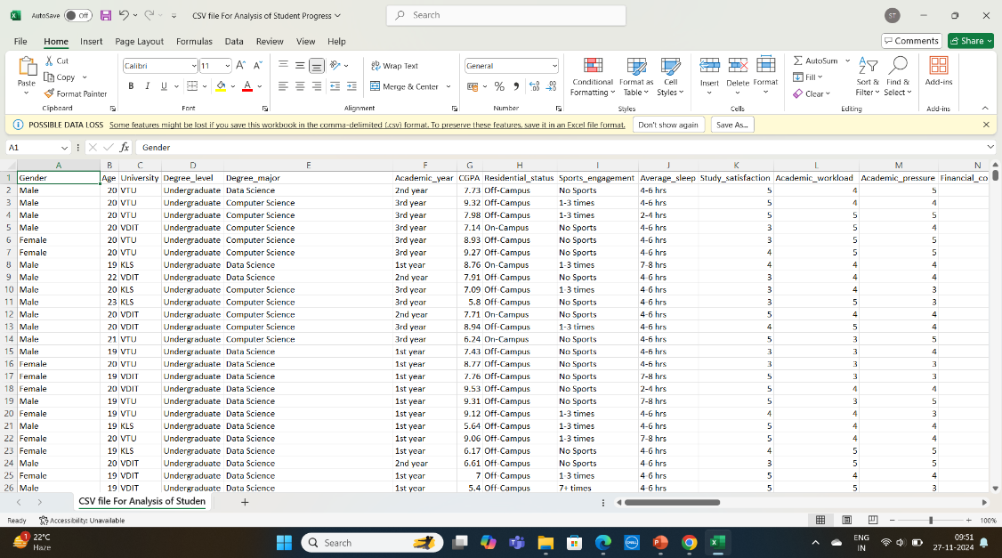
Proposed Methodology
CSV FILE
Data Collection: Gather data from student management systems, exam records, and attendance logs.
Data Preparation: Clean and transform the data to ensure consistency and accuracy.
Dashboard Design: Create a user-friendly layout focused on the defined KPIs.
Visualization: Use charts, tables, and filters for trends and individual performance insights.
Testing and Feedback: Test for accuracy and usability, and refine based on user feedback.
An Interactive Power BI Dashboard for Analyzing Student Performance

Slide 9
System Implementation
1. Data Collection and Preparation:Gather academic, behavioral, and socioeconomic data, preprocess it to ensure accuracy, and integrate it into a unified dataset for analysis.
2. Analysis and Insights:Conduct exploratory and predictive analysis to uncover key performance factors, identify at-risk students, and derive actionable insights.
3. Dashboard Design and Development:Build an interactive Power BI dashboard with dynamic visualizations, customizable features, and user-friendly layouts for comprehensive data exploration.
4. Deployment and Continuous Improvement:Deploy the dashboard securely, gather user feedback, and update it regularly to enhance functionality and adapt to evolving needs.
An Interactive Power BI Dashboard for Analyzing Student Performance

Slide 10
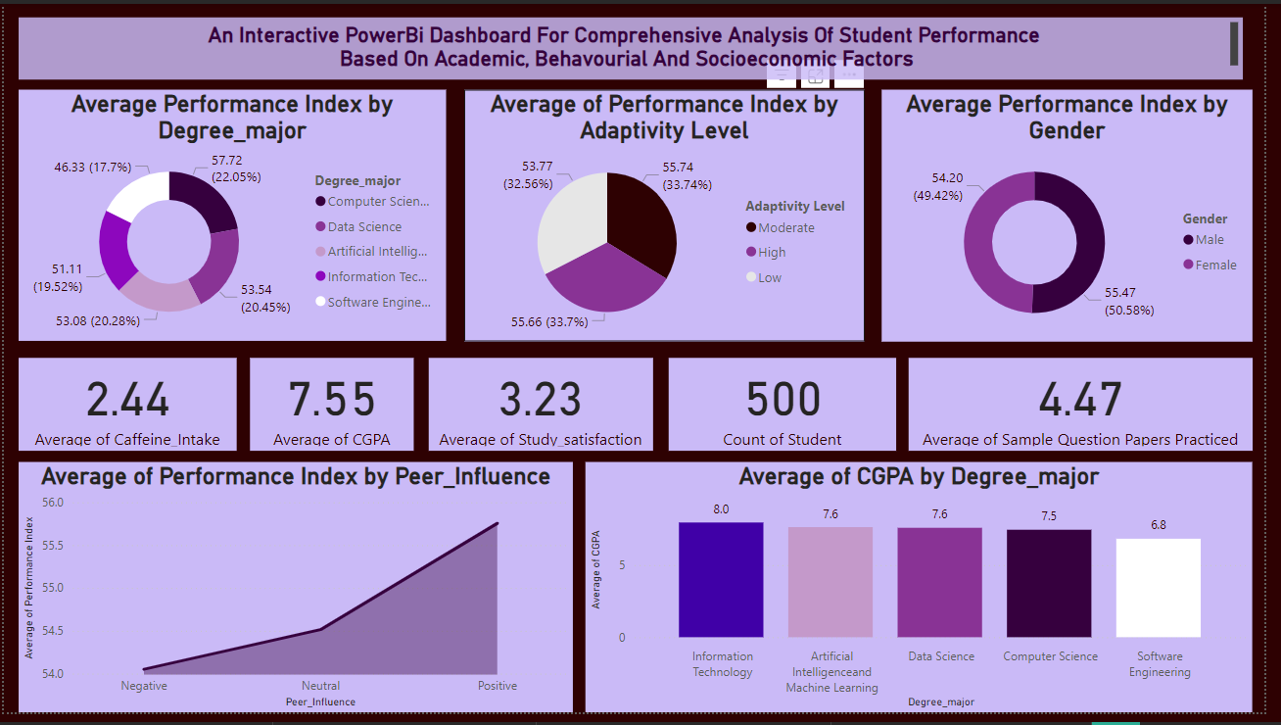
Performance Insights by Major and Factors
Performance by Major : Computer Science leads in performance (57.72), while Software Engineering lags (46.33), highlighting areas for improvement.
Adaptability & Performance: High adaptability students perform best (56.00), suggesting the value of adaptability-building programs.
Gender Equality: No performance gap between male and female students (54.20), indicating the need for gender-neutral support.
Peer Influence: Positive peer influence boosts performance (55.37), while negative influence lowers it (52.32), emphasizing the need for fostering positive peer interactions.
CGPA by Major: IT has the highest average CGPA (8.23), Software Engineering the lowest (5.38), signaling the need for academic support in struggling fields.
An Interactive Power BI Dashboard for Analyzing Student Performance

Slide 11
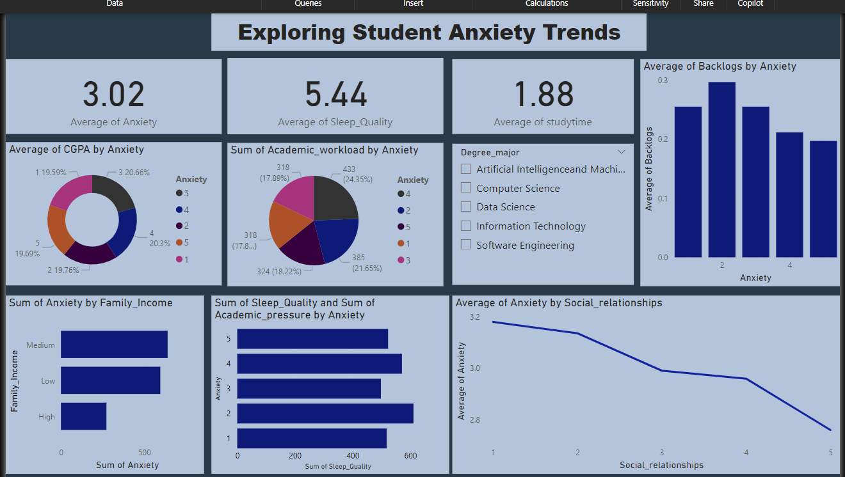
Exploring Student Anxiety Trends
Donut Chart: Displays the average CGPA by anxiety levels, providing a visual breakdown of academic performance trends linked to anxiety
Pie Chart: Summarizes the total academic workload by anxiety levels, highlighting how academic pressure varies among students with different anxiety levels.
Slicer with Degree Majors: Includes a slicer for filtering data by degree programs such as Computer Science, Data Science, AI & ML, IT, and Software Engineering, allowing targeted analysis.
Clustered Column Chart: Visualizes the average number of backlogs by anxiety levels, revealing patterns of academic challenges.
Stacked Bar Chart: Compares sleep quality and academic pressure against anxiety levels, showing overlapping effects on student well-being.
Line Chart: Tracks the average anxiety levels by social relationships, uncovering the influence of peer connections on mental health.
An Interactive Power BI Dashboard for Analyzing Student Performance

Slide 12
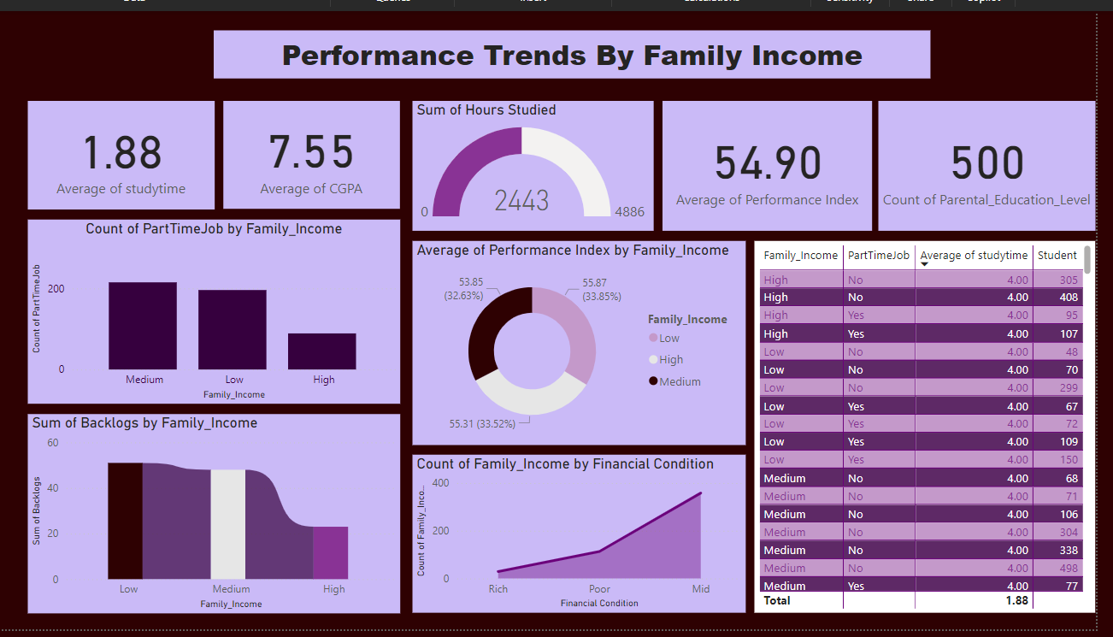
Performance Trends By Family Income
Donut Chart :Displays the average performance index by family income, offering a clear view of academic trends across income categories.
Bar Charts :Part-Time Jobs by Family Income:Highlights that students from medium-income families have the highest count of part-time jobs.
Backlogs by Family Income :Reveals that low-income students face the most academic challenges with the highest backlog count, while high-income students have the least.
Line Chart: Tracks financial conditions by family income, illustrating the distribution of students among "rich," "mid," and "poor" categories.
Table Visualization: Summarizes metrics such as study time, part-time job involvement, and performance index for detailed comparisons across income levels.
An Interactive Power BI Dashboard for Analyzing Student Performance

Slide 13
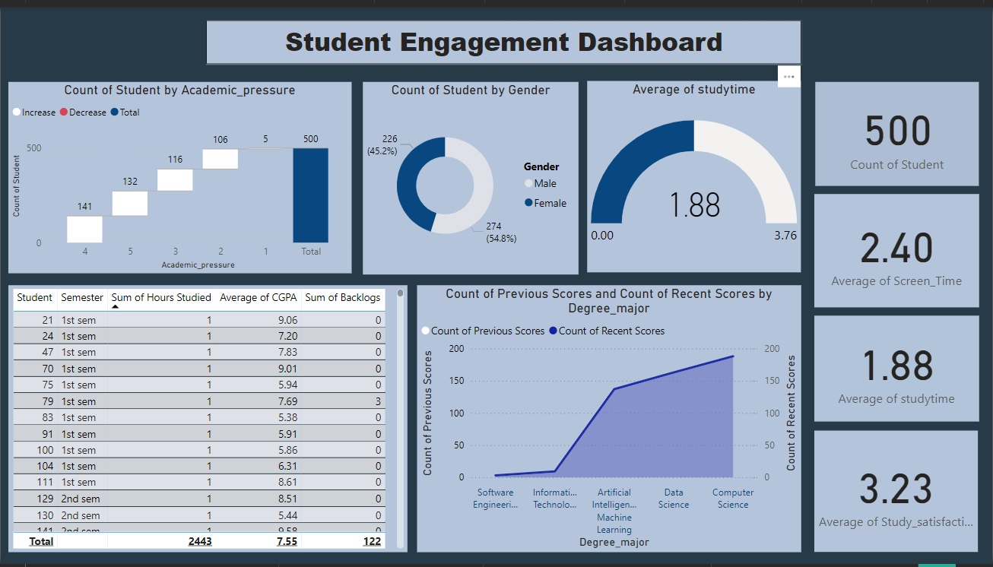
Student Engagement Dashboard
Waterfall Chart:Displays the count of students by academic pressure, breaking down how varying levels of pressure impact student engagement.
Pie Chart: Illustrates the count of students by gender, providing a quick demographic overview.
Gauge Chart:Highlights the average study time, showcasing how much time students spend on academic activities.
Table View:Lists student data by semester, including: Sum of study hours, Average CGPA, Sum of backlogs for a detailed snapshot of academic performance.
Area Chart:Visualizes the count of previous and recent scores by degree major, showing academic trends and progression across disciplines.
An Interactive Power BI Dashboard for Analyzing Student Performance

Slide 14
Conclusion
1.Holistic Student Insights: The dashboard integrates academic, behavioral, and socioeconomic data, providing a comprehensive view of factors affecting student performance.
2. Data-Driven Decision Making: It empowers educators and administrators to make informed decisions about interventions, resource allocation, and curriculum adjustments.
3. Personalized Support: By identifying key performance drivers like mental health and study habits, the dashboard helps institutions offer targeted, personalized interventions for students.
4. Real-Time Analysis: The interactive nature of Power BI allows for real-time data visualization, making it easier to identify trends, patterns, and at-risk students.
5. Promotes Equity: The dashboard highlights disparities in academic outcomes based on demographic factors, supporting initiatives to improve equity and inclusion in education.
An Interactive Power BI Dashboard for Analyzing Student Performance

Slide 15
THANK YOU
An Interactive Power BI Dashboard for Analyzing Student Performance

